Slide 1
Forensic science in international perspectives
Abhishek Prajapati
Research Scholar
National Forensic Sciences University

Slide 2
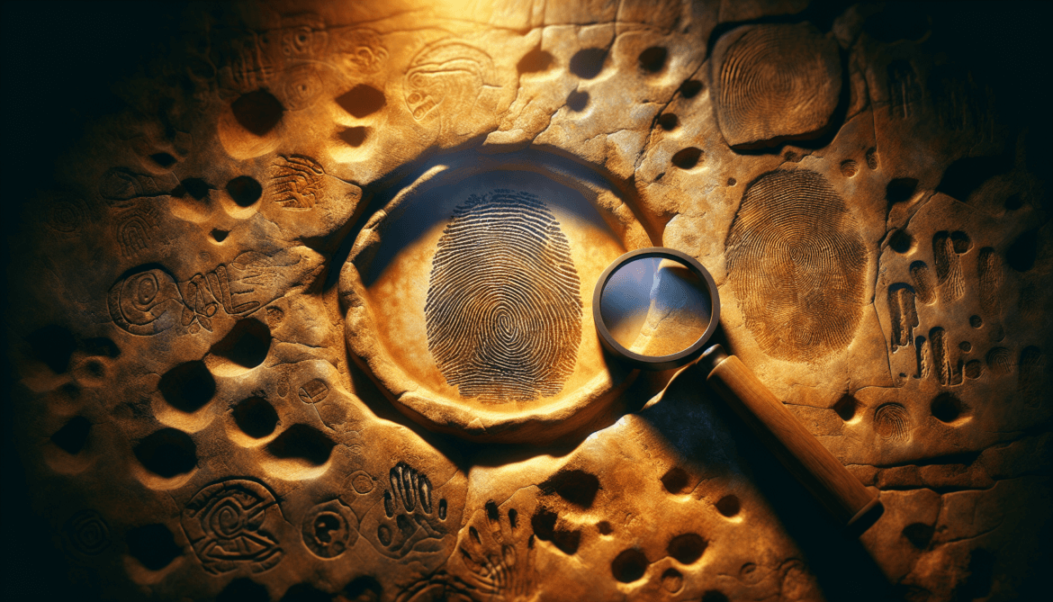
Ancient & Early Foundations
Ancient China: First to use fingerprints for identifying owners of objects (e.g., pottery).
Rome (1,000+ yrs ago): Bloody palm prints used as evidence in trials.
Marcello Malpighi (17th c.): Noted fingerprint ridges but no classification.
1810: Eugène Vidocq founded first detective force – Sûreté of Paris.

Slide 3
Fingerprint Revolution (1800s)
1823 – Jan Purkinje: Classified 9 types of fingerprints.
1880 – Henry Faulds: Suggested fingerprints for personal ID (Nature journal).
1890s – Francis Galton: Published “Finger Prints”, proved uniqueness.
1891 – Juan Vucetich: Created fingerprint classification system (used in S. America).
Sir Edward Henry: Developed fingerprint system adopted by US & Europe

Slide 4
Rise of Crime Labs & Organizations (1900s)
1910 – Edmond Locard: Opened 1st crime lab in Lyon, France; proposed Locard’s Exchange Principle.
1930 – Calvin Goddard launched first forensic science journal in U.S.
1932 – FBI Lab founded by J. Edgar Hoover.
1937 – Paul Kirk: Started 1st U.S. university-based forensic program (UC Berkeley).
1950 – AAFS founded in Chicago; later published the Journal of Forensic Sciences.

Slide 5
Blood & DNA Milestones
1853 – Ludwig Teichmann: Developed first crystalline test for blood (hemoglobin).
1863 – Schönbein: Introduced hydrogen-peroxide presumptive blood test.
1900 – Karl Landsteiner: Discovered ABO blood groups → Nobel Prize 1930.
1915 – Leone Lattes: Created method to type dried bloodstains.
1983 – Kary Mullis: Developed PCR – basis of modern DNA testing → Nobel Prize.
1984 – Sir Alec Jeffreys: Pioneered DNA fingerprinting, solved first DNA-based murder case.

Slide 6
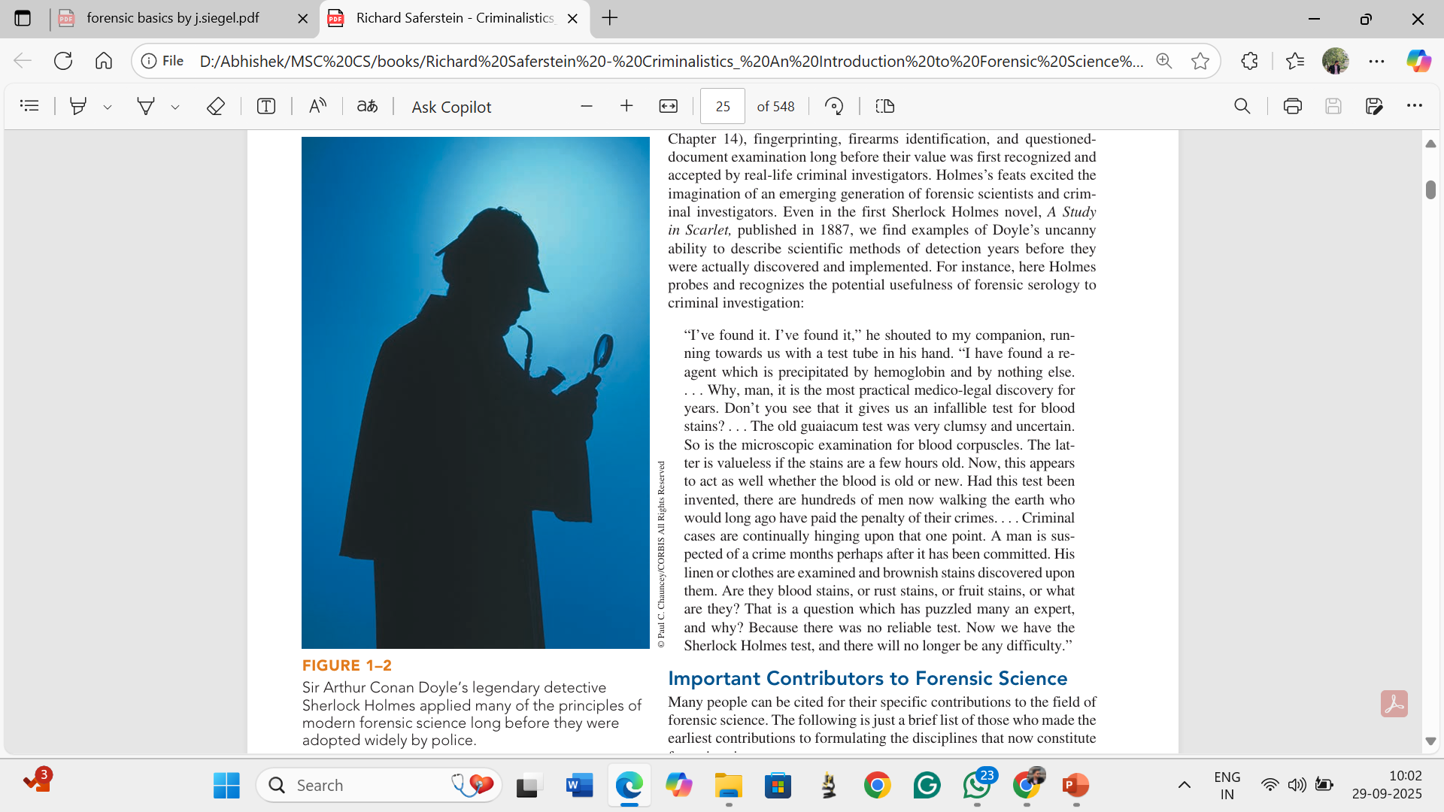
Sir Arthur Conan Doyle’s Influence on Forensic Science
Sherlock Holmes & Science: Doyle’s fictional detective popularized scientific crime detection before its real-world adoption.
Pioneering Techniques Highlighted: Forensic serology (blood analysis), Fingerprinting, Firearms identification, Questioned-document examination
A Study in Scarlet (1887) Novel: Introduced a “blood reagent test” for detecting hemoglobin, predicting future medico-legal methods.
Impact: Holmes’s methods inspired generations of forensic scientists and helped shape modern investigative practices.

Slide 7
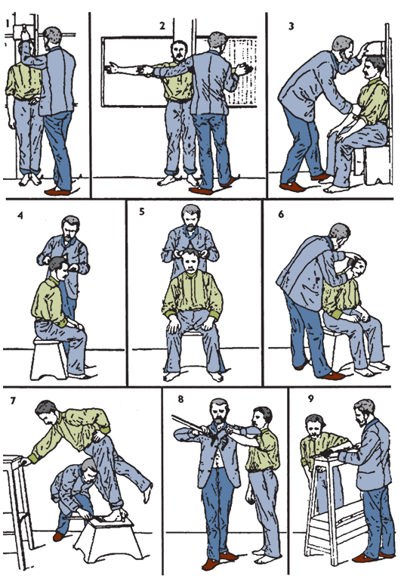
Founders of Key Disciplines
Mathieu Orfila (1787–1853) – Father of Forensic Toxicology, Published first scientific treatise on detection of poisons (1814).
Alphonse Bertillon (1853–1914) – Father of Criminal Identification, Developed Anthropometry – first scientific personal ID system.
Francis Galton (1822–1911) – Pioneer of Fingerprint Classification, Published “Finger Prints” (1892) proving fingerprint uniqueness.
Hans Gross (1847–1915) – Father of Criminalistics, Authored “Criminal Investigation” (1893) introducing scientific methods.

Slide 8
Advancing Forensic Methods
Leone Lattes (1887–1954): Devised first method (1915) to identify blood groups in dried bloodstains.
Calvin Goddard (1891–1955): Introduced comparison microscope for firearms & bullet analysis.
Albert S. Osborn (1858–1946): Authored “Questioned Documents” (1910); revolutionized document examination.
Walter C. McCrone (1916–2002): World-renowned microscopist; applied microscopy to solve thousands of cases.

Slide 9
Edmond Locard – Linking Suspect & Crime Scene
Founded first police laboratory in Lyon, France (1910).
Established Locard’s Exchange Principle: “Every contact leaves a trace.”
Demonstrated the transfer of materials (e.g., metal particles in counterfeit coin case).
Inspired the creation of police labs in Vienna, Berlin, Sweden, Finland, Holland.

Slide 10
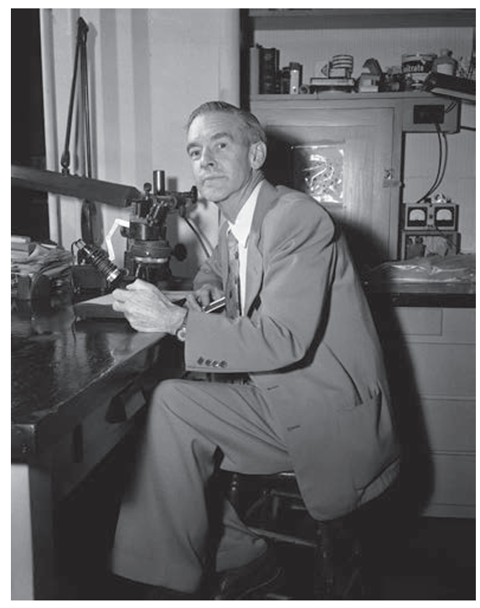
Crime Laboratories: A Global Perspective
Early Development in the United States
1923 – LAPD Crime Lab: Founded by August Vollmer, first U.S. forensic lab.
1932 – FBI National Lab: Established by J. Edgar Hoover, offered services to all law enforcement agencies.
1948 – UC Berkeley School of Criminology: Led by Paul Kirk, trained many future criminalists.
FBI Lab: Became world’s largest, performing 1+ million exams annually.
Paul Kirk, 1902–1970

Slide 11
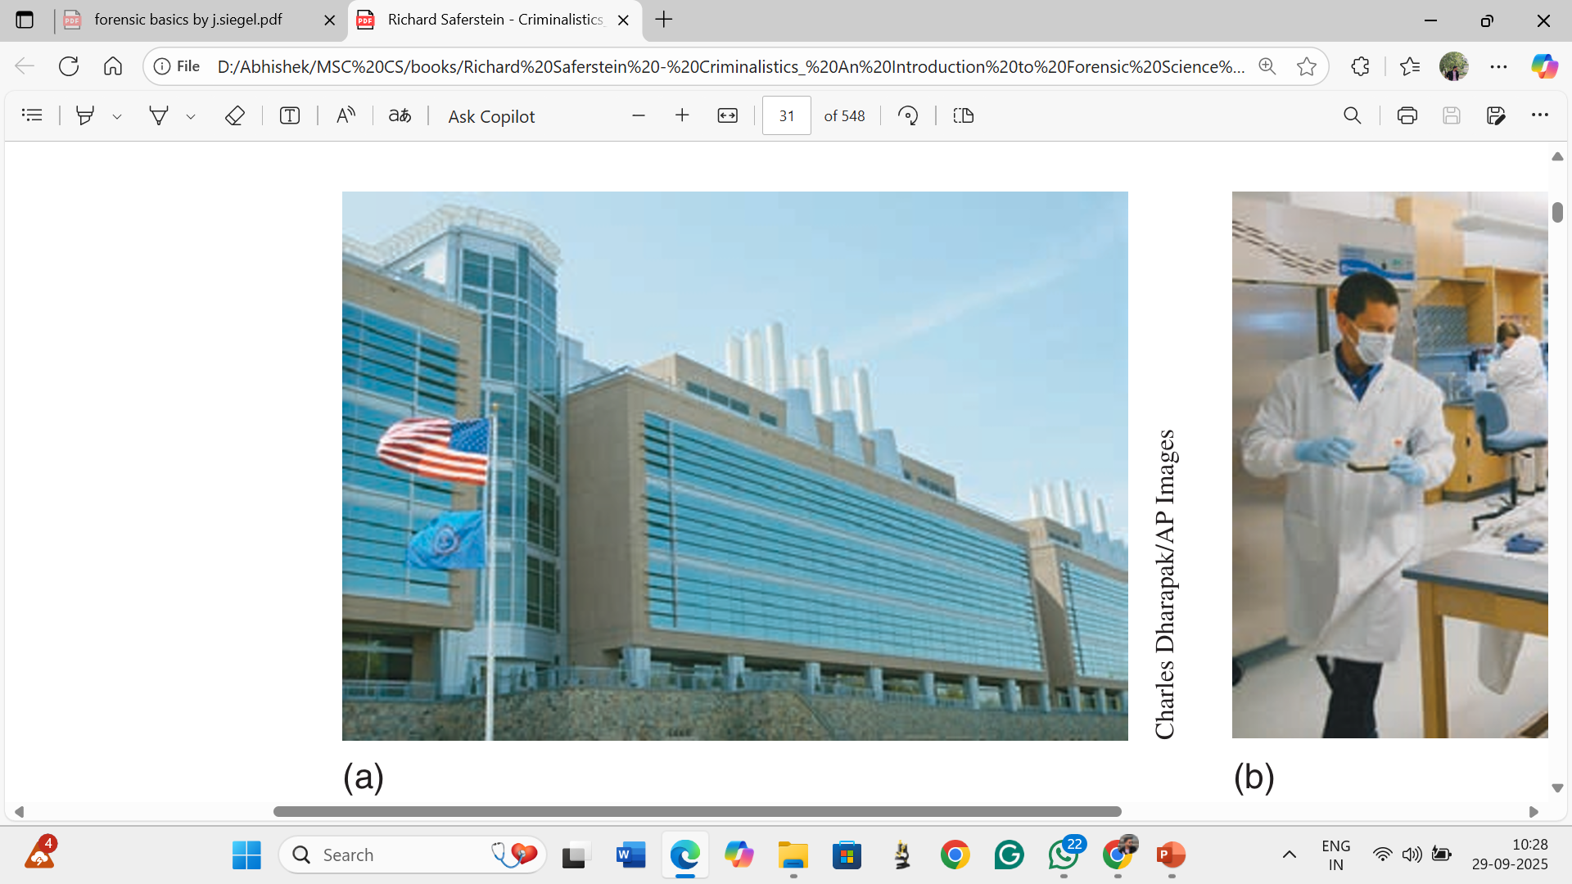
Growth & Integration in the U.S.
Expansion and Training
1981 – FBI Forensic Science Research & Training Center:
Developed new scientific methods
Trained crime lab personnel nationwide
1972 – California DOJ Network:
Created regional + satellite forensic labs
Promoted cooperation via California Association of Criminalists
Impact: U.S. model inspired other countries’ forensic networks.
FBI crime laboratory in Quantico, Virginia

Slide 12
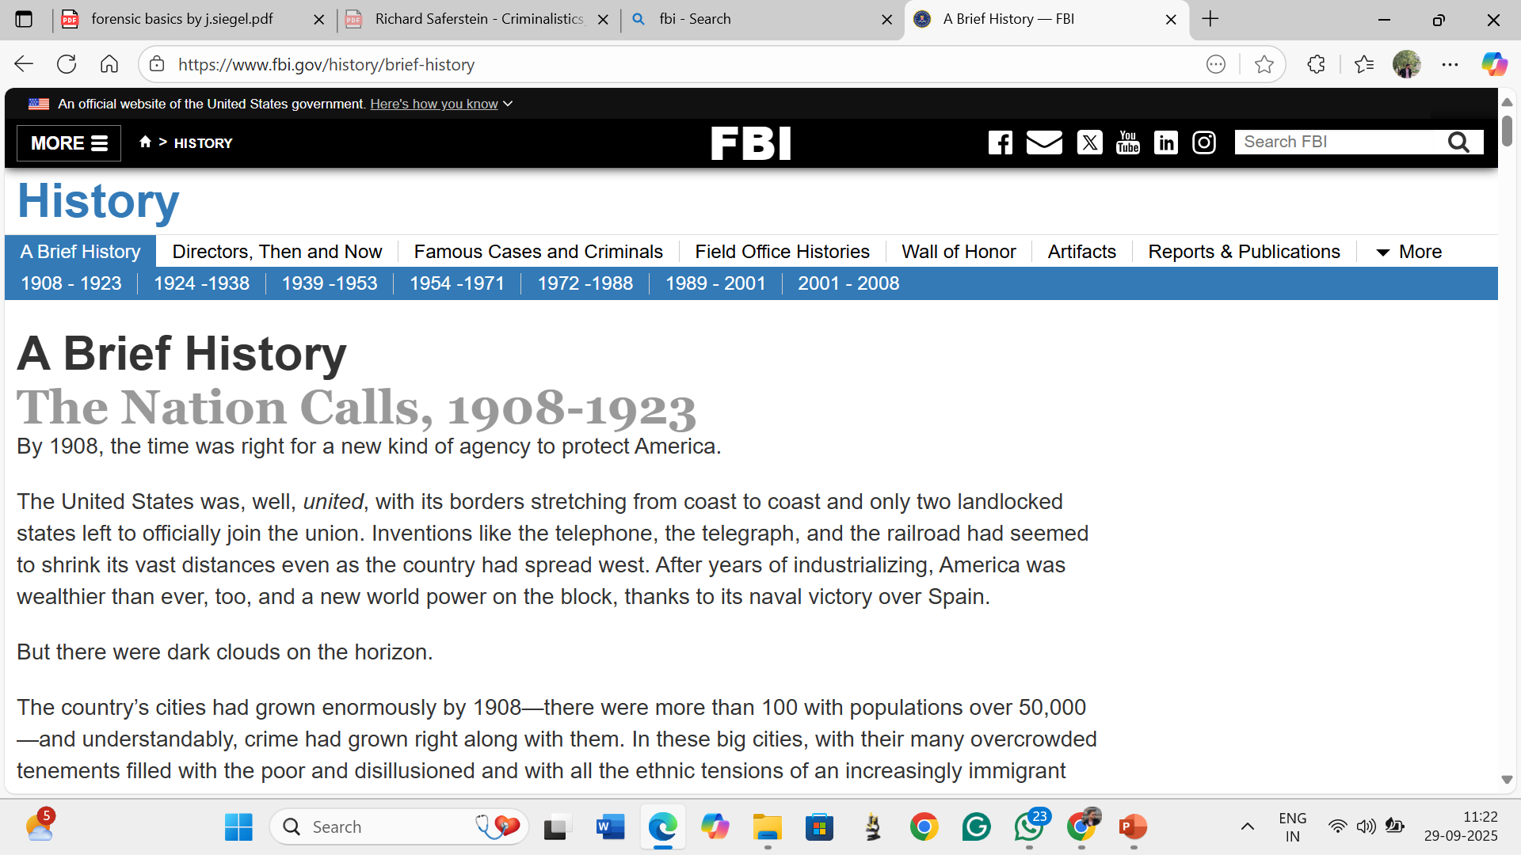
FBI & Its Forensic Laboratory
1905: President Teddy Roosevelt established the FBI
1932: FBI Laboratory founded – a landmark in U.S. forensic science
Location: Quantico, Virginia – supported by Forensic Science Research & Training Center (FSRTC)
Among the world’s most prestigious forensic labs
Supports law enforcement & anti-terrorism missions
Analyzes evidence for federal, state, and local agencies
International collaboration: FBI experts assist in cases involving U.S. citizens abroad

Slide 13
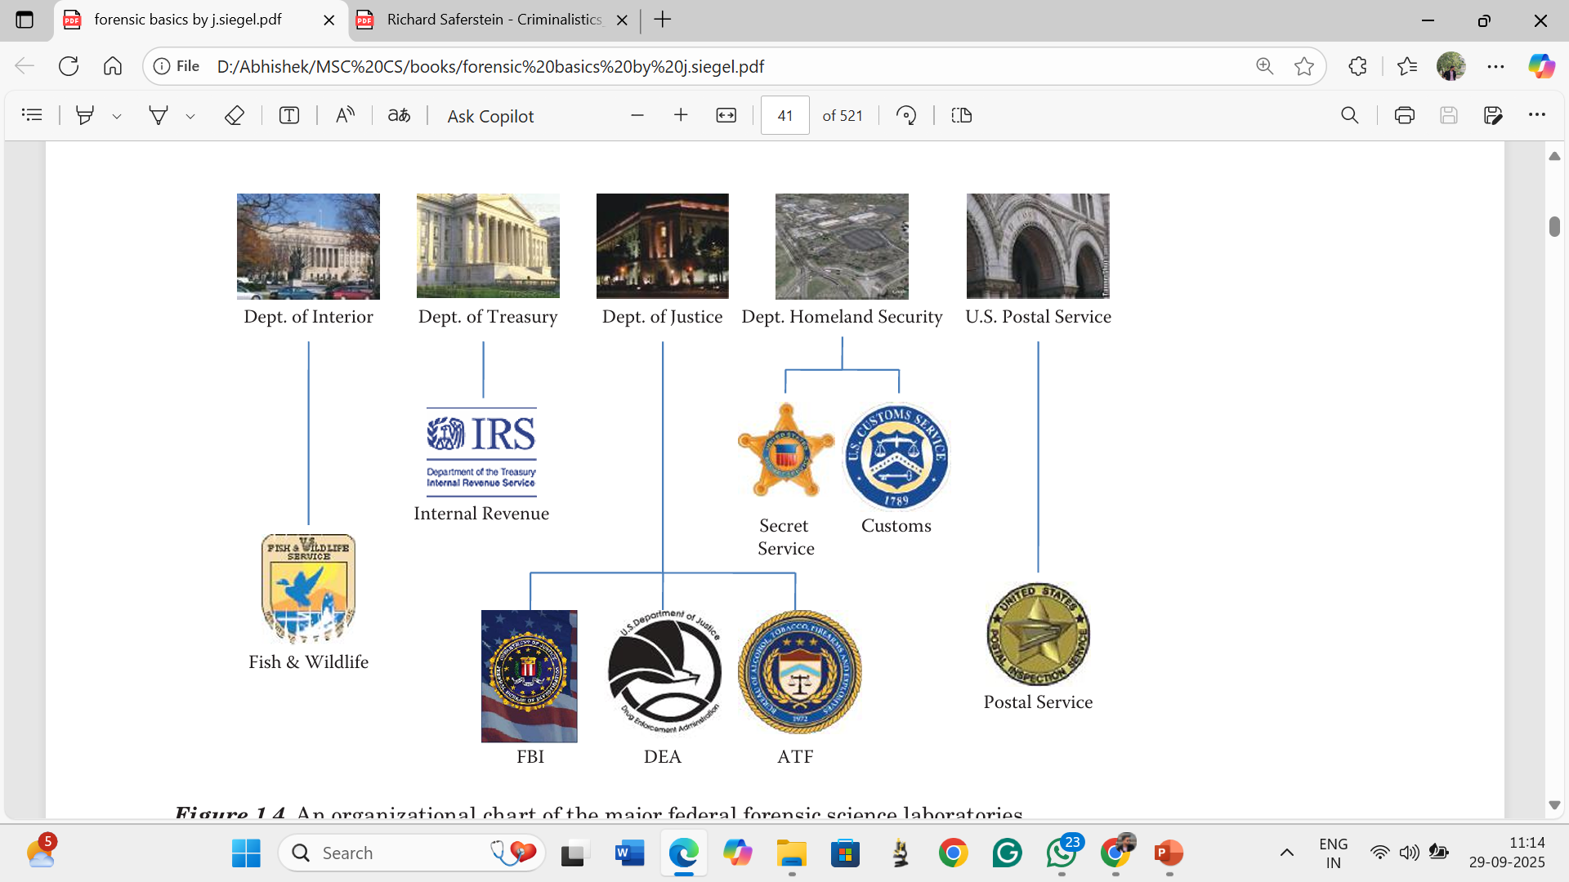
Other Federal Laboratories
Counterfeiting
& protective
threat analysis
Questioned documents
Wildlife crime investigations
(Ashland, Oregon)
USPS: Document analysis & trace evidence in mail crimes
Illicit drug
analysis
BATF: Firearms, arson, and
explosives expertise

Slide 14
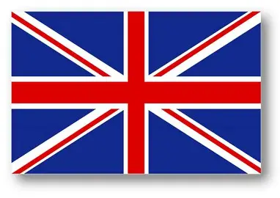
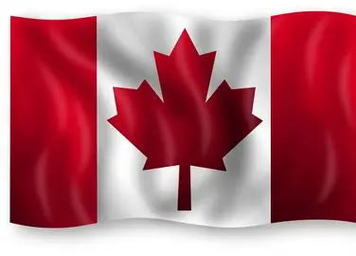
International Crime Laboratories
United Kingdom:
Former Home Office regional labs →1990: Forensic Science Service (FSS)
Fee-for-service system → private labs (e.g., LGC 2010)
2012: Closure of FSS; private sector now dominant
Canada: 3 government-funded systems:
six Royal Canadian Mounted Police (RCMP) regional labs (first in 1937, Regina)
Centre of Forensic Sciences – Toronto
Institute of Legal Medicine & Police Science – Montreal

Slide 15
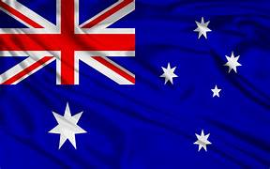
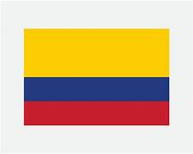
International Crime Laboratories
Australia:
7 states each support forensic laboratories
Victoria Police Science Centre (Melbourne) – full-service lab
New South Wales has a fragmented system: separate labs for firearms, fingerprints, drugs, and chemical evidence
Australian Federal Police lab located in Canberra
Colombia:
4 regional forensic laboratories
3 under federal law enforcement (Prosecutor General & national police)
1 medical lab supporting the national medical examiner system
Altogether, more than a hundred countries throughout the world have at least one laboratory facility offering services in the field of forensic science.

Slide 16
References
Siegel, J. A., & Mirakovits, K. (2015). Forensic science: the basics. CRC Press.
Saferstein, R. (2013). Criminalistics. Pearson Education.

